Slide 1
Module 3
Managing people, development and growth, engagement
Justin Kinnear
Helena McCanney
Notes:
traffic / busy
engage / energy
meet others
talk, think, take away
break at 11:00
blank display - pairs - something that made an impression

Slide 2
Programme team
Programme team
Justin Kinnear Leadership Consultant, HPC
Helena McCanney
Senior Learning and Organisational Development Officer

Slide 3
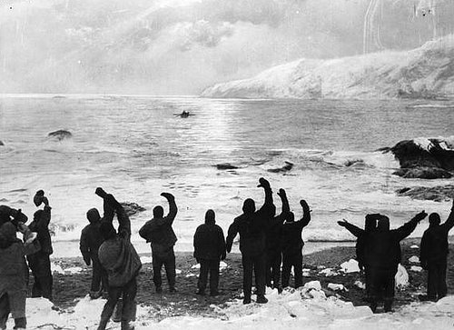
Welcome Back

Slide 4
Agenda
Communication and trust
Motivation and engagement
Dealing with conflict
Developing your team
Next steps

Slide 5
Learning outcomes
By the end of today’s session you will
Apply proven methods to help motivate staff and build trust
Advance your communication and influencing skills
Manage conflict effectively
Recognise key best practices for successfully managing people

Slide 6
Communicating effectively as a leader

Slide 7
Do
Don’t
Summarise
Paraphrase
Ask clarifying questions
Make eye contact
Nod
Use open body posture
Share observations
Show curiosity
Ask open questions
Remain present
Show appreciation
Focus entirely on the task
Interrupt (including silences)
Make assumptions (e.g. that this conversation is effective)
Do most of the talking
Run out of time
Finish sentences
Say “Yes but…”
Say “I know how you feel”
Say “Me too…”
Notes:
Not summarizing
Asumptions
Doing the most of the talking
Yes but
Interupting
Running out of time
Judgemental
Assuming the conversation has been effective – what would make this conversation more effective?
Examples
Eye contact
Nod
Paraphrase/ summarise
Name the emotions / observations
Don’t finish sentences or say ‘I know how you feel’
Ask what else? Tell me more

Slide 8
Break

Slide 9
Notes:
Cards 10 pictures and 10 statements – interpretation – how do these things affect motivation.

Slide 10
Handling conflict
Notes:
From CIPD - obvious sources of conflict at work include:
any form of bullying behaviour or harassment
any form of discriminatory behaviour
poor performance
poor attendance and time-keeping
unacceptable language
excessive personal use of the internet or email
theft
drink or drug problems.
Others less obvious sources include:
differences in personality style or working
taking credit for other people’s work or ideas
not valuing other people’s views, background or experiences
talking over people in meetings
failing to include people in round-robin emails
ignoring people or being discourteous
poor personal hygiene.
Often, it’s these more subtle behaviours that, over time, if not tackled, lead to workplace disputes.

Slide 11
Effective conflict management
Use active listening
Get to know your team better
Be aware of underlying tensions
Acknowledge when a team member is causing stress to others
Be clear about your expectations of team conduct
Don’t get involved in office politics or gossip
Don’t avoid, but don’t go overboard
Facilitate when necessary and remain objective
Aim for a first small step that all parties agree to take

Slide 12
Lunch

Slide 13
A recap of today’s main ideas
Notes:
Recap of main points
Recommendations for completing the actions arising from this module
Guidance for your upcoming 1-1 meeting with your coach

Slide 14
Follow-on BUILDING YOUR INFLUENCE
Dr. Robert Cialdini's Seven Principles of Persuasion
How to Increase Your Influence at Work

Slide 15
Your next steps: - Practice active listening - Keep track of promises you make - Observe others – what’s my impact? - Attend peer group meeting - Complete follow-on - Move on to prework for Module 4

Slide 17
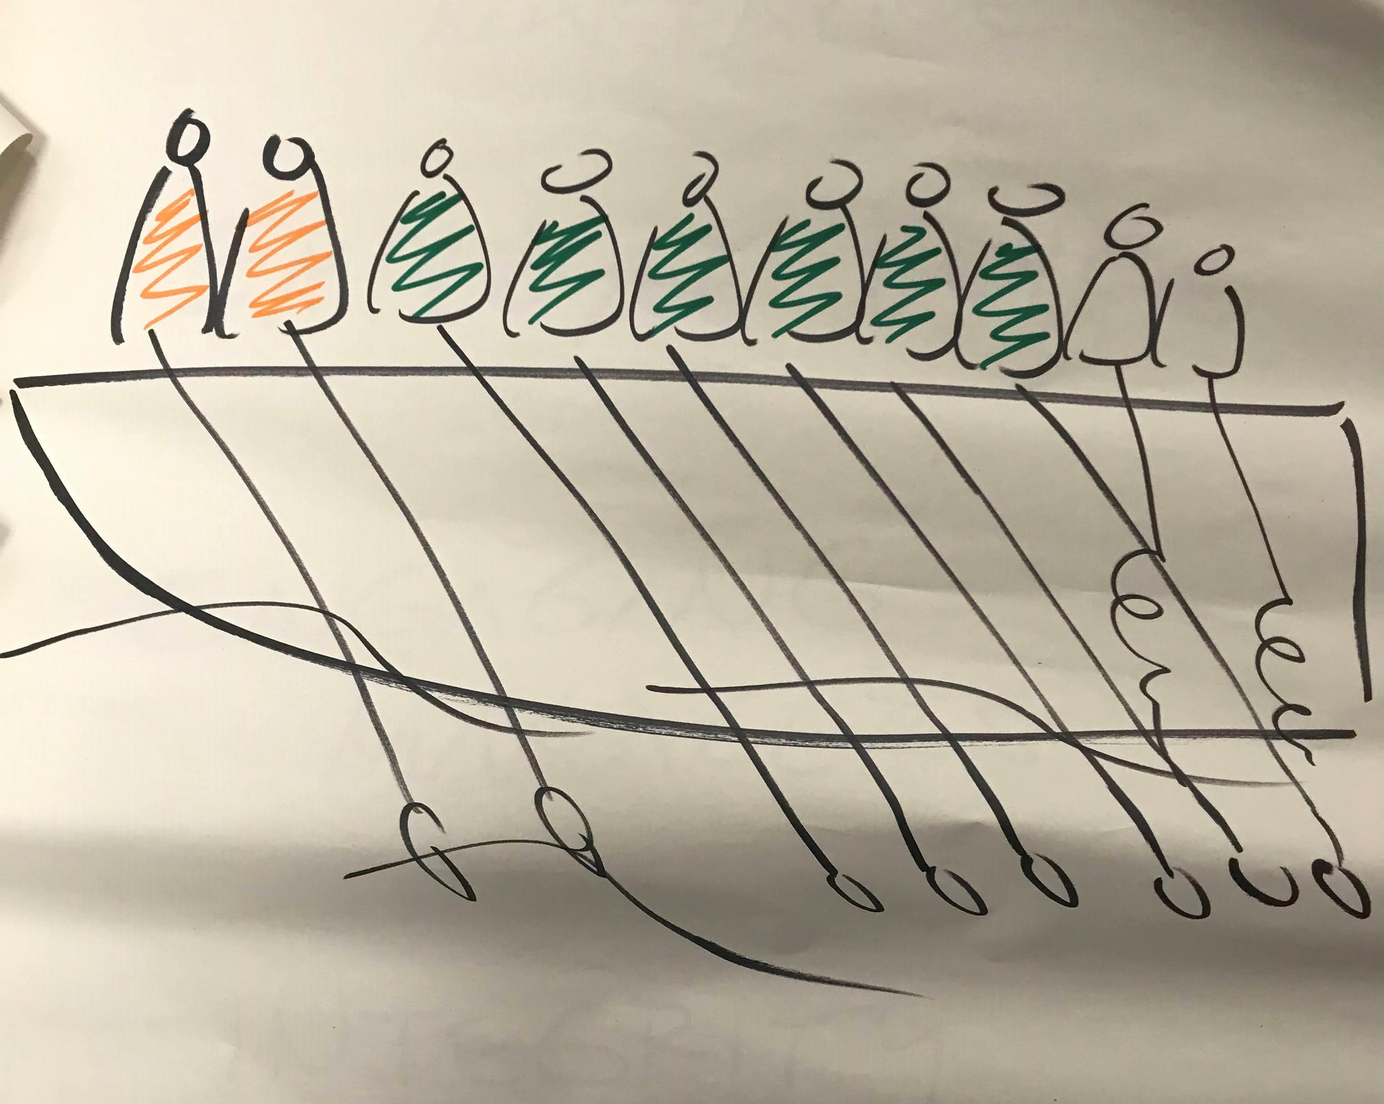
Employee Engagement –
Who’s sinking your boat?
Can you help them?

Slide 18
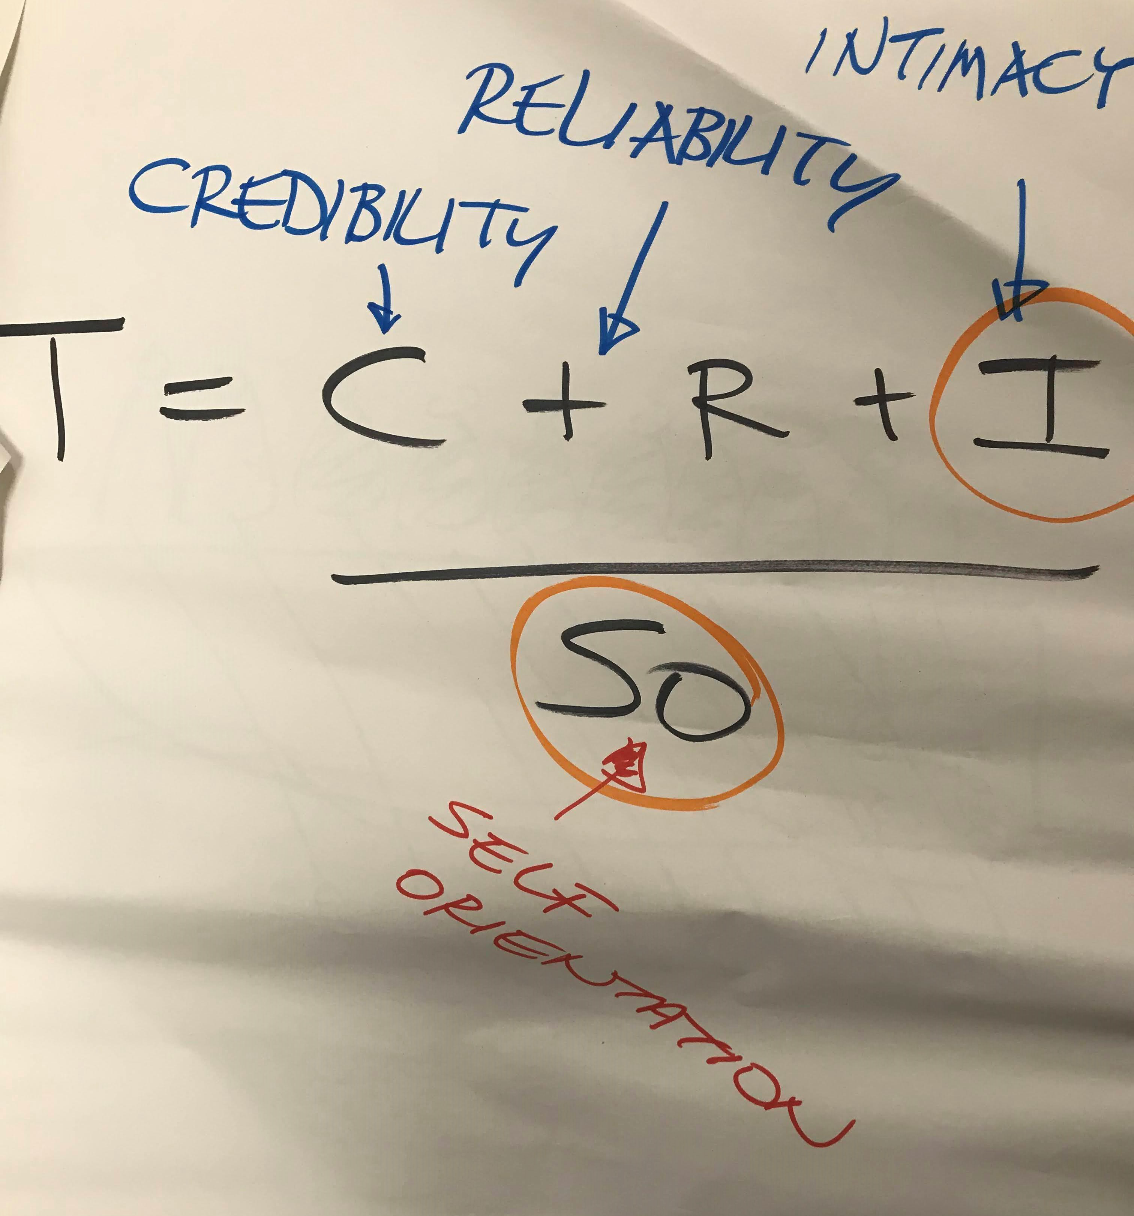
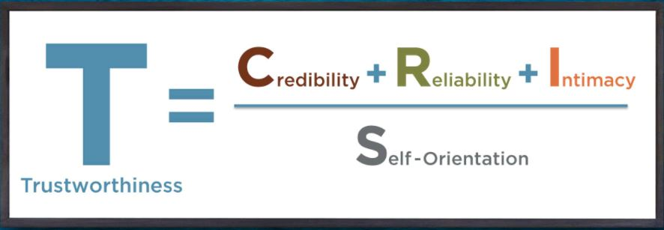
The Trust Equation

Slide 19
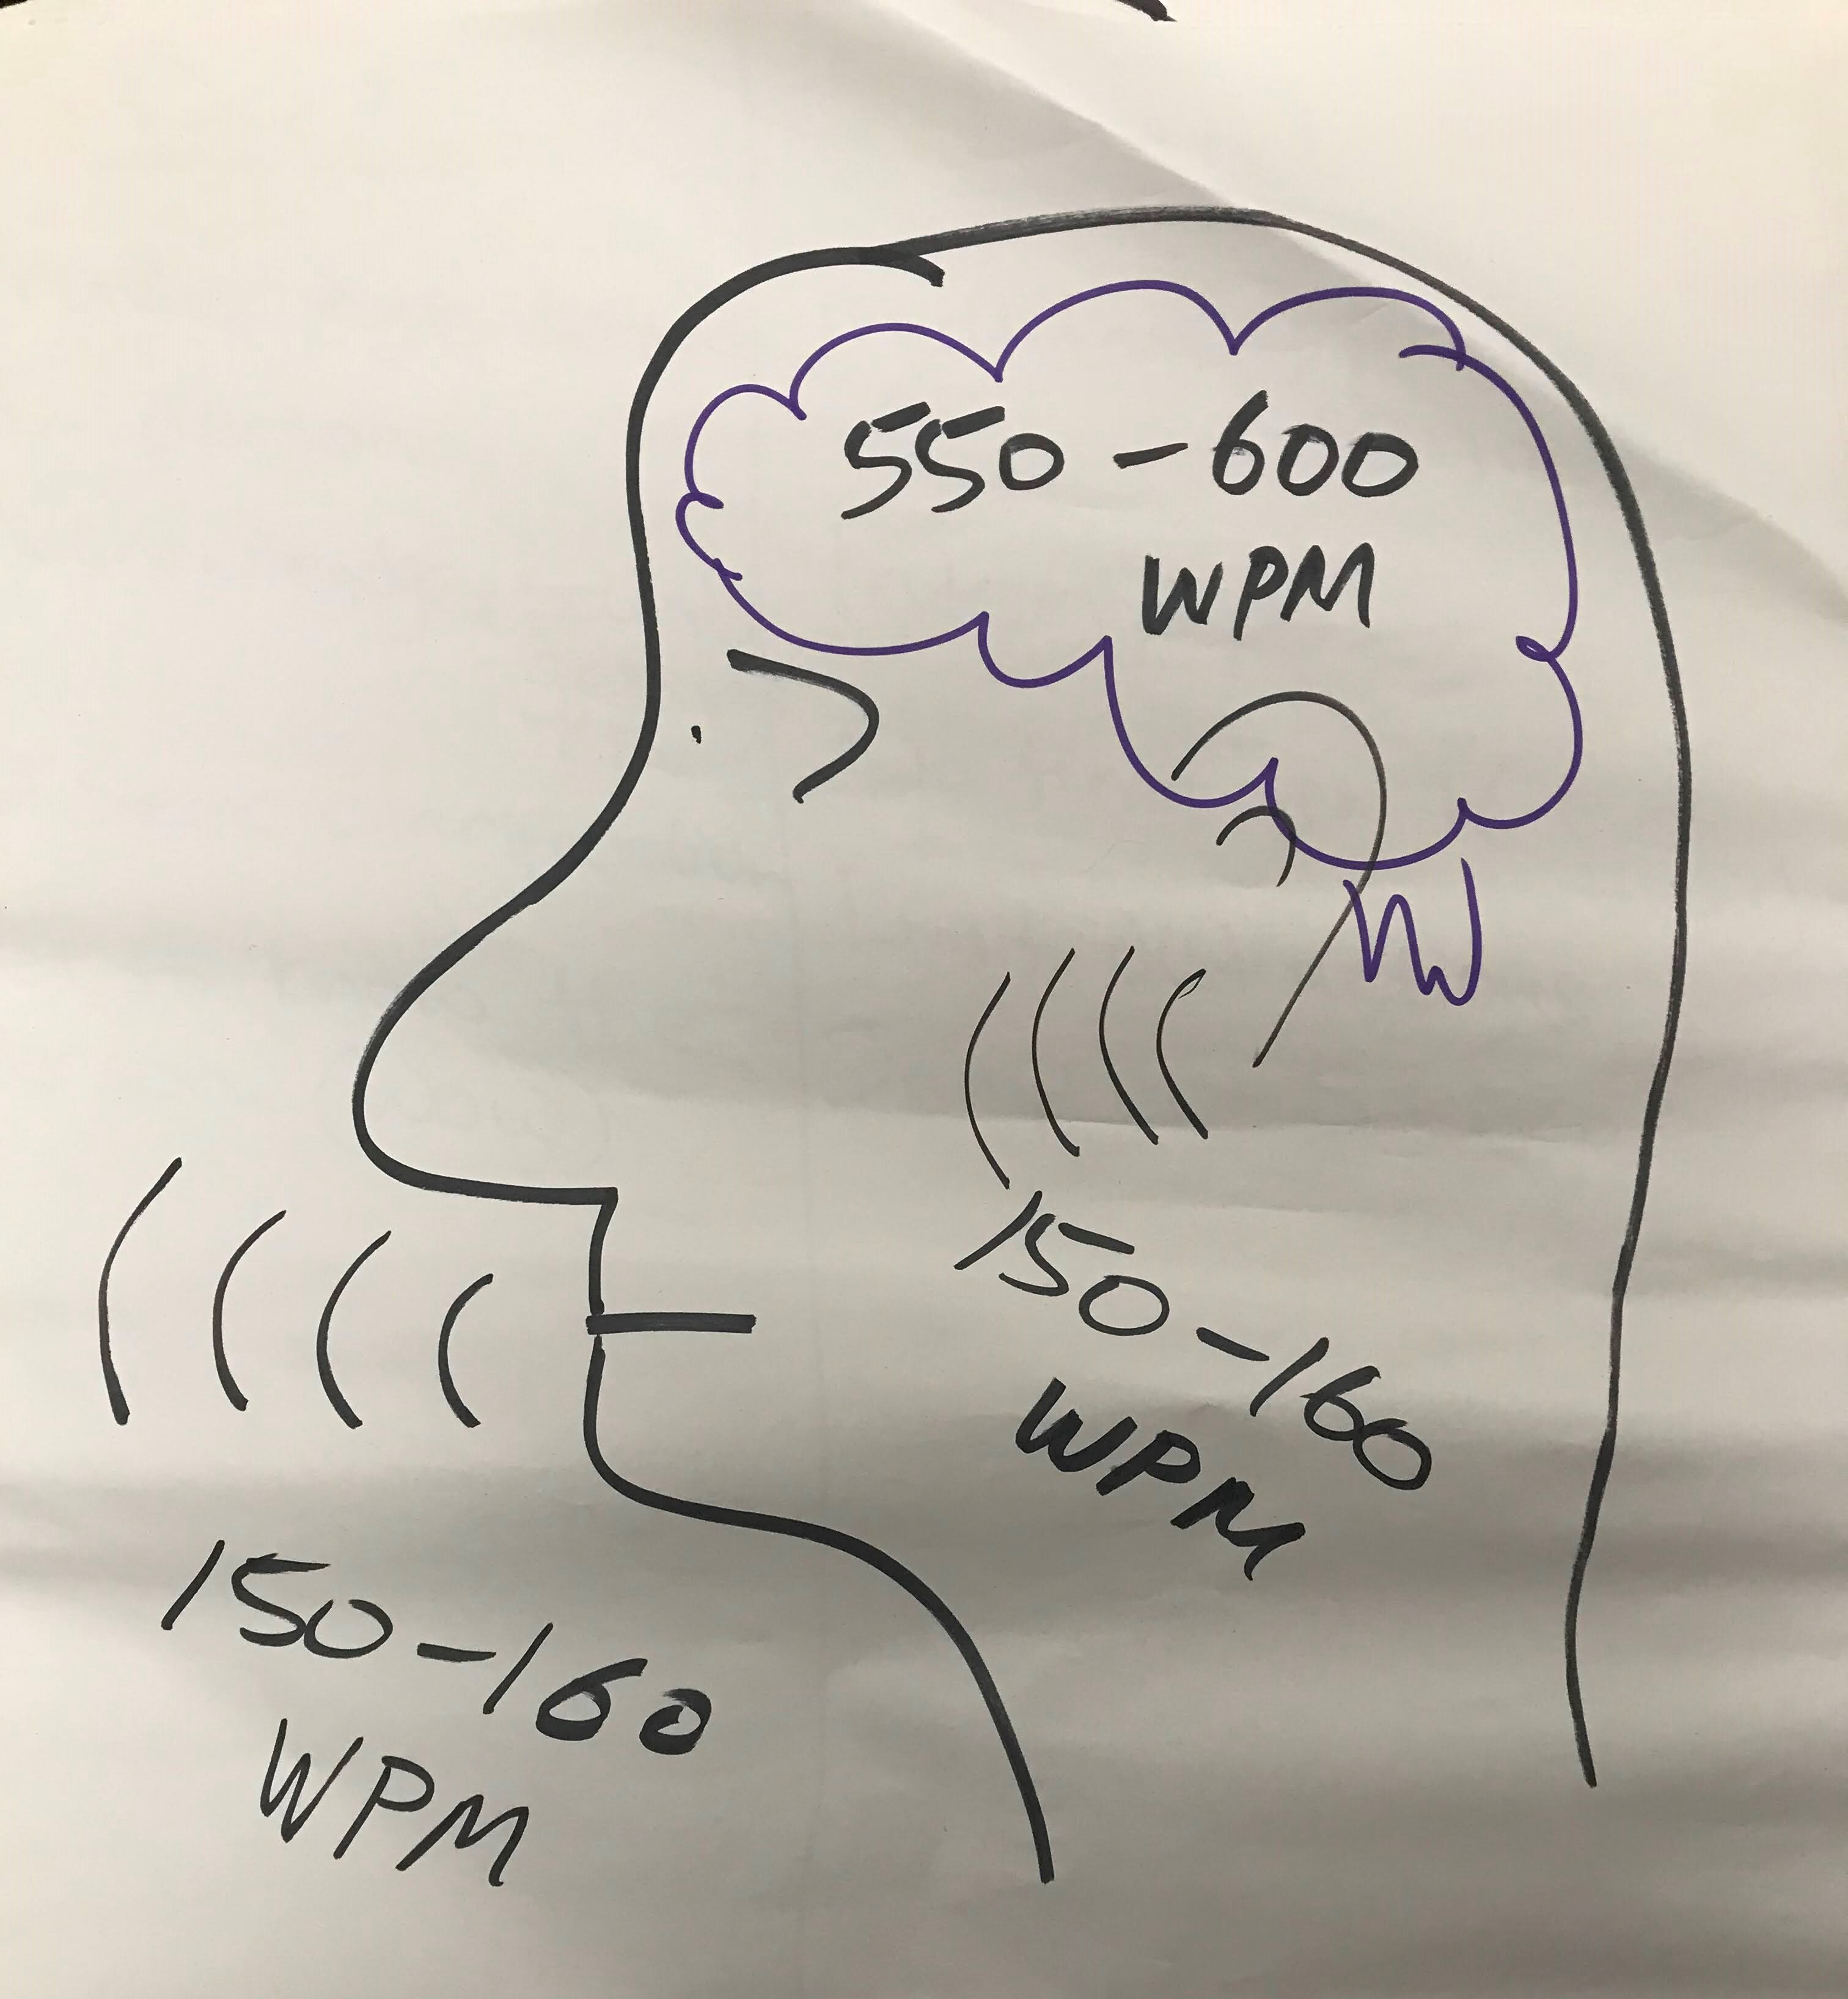
Social Listening

Slide 20
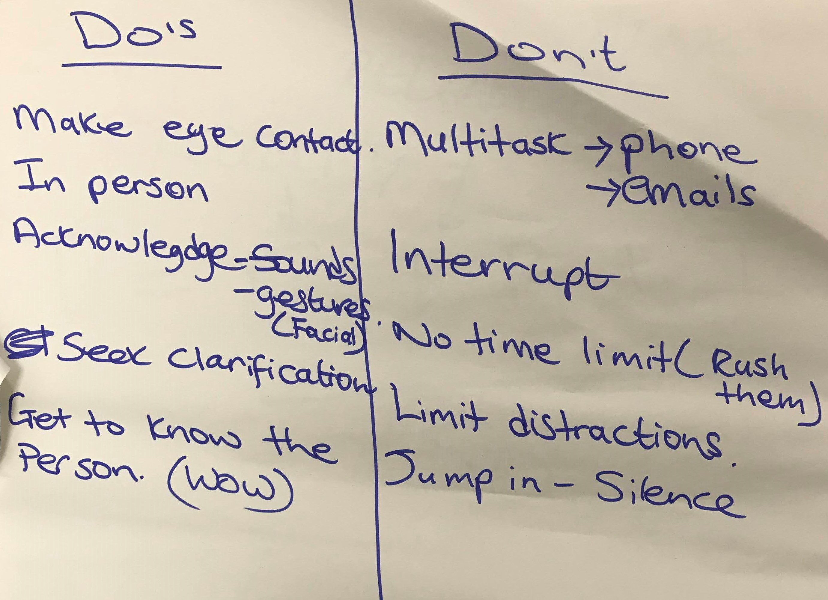
Listening well

