Slide 1

“Revise Wisely”
Student Learning
Revision Strategies
www.dcu.ie/studentlearning

Slide 2

Steps to success
WHAT to study
WHEN to study it
HOW to study it

Slide 3

1. WHAT

Slide 4
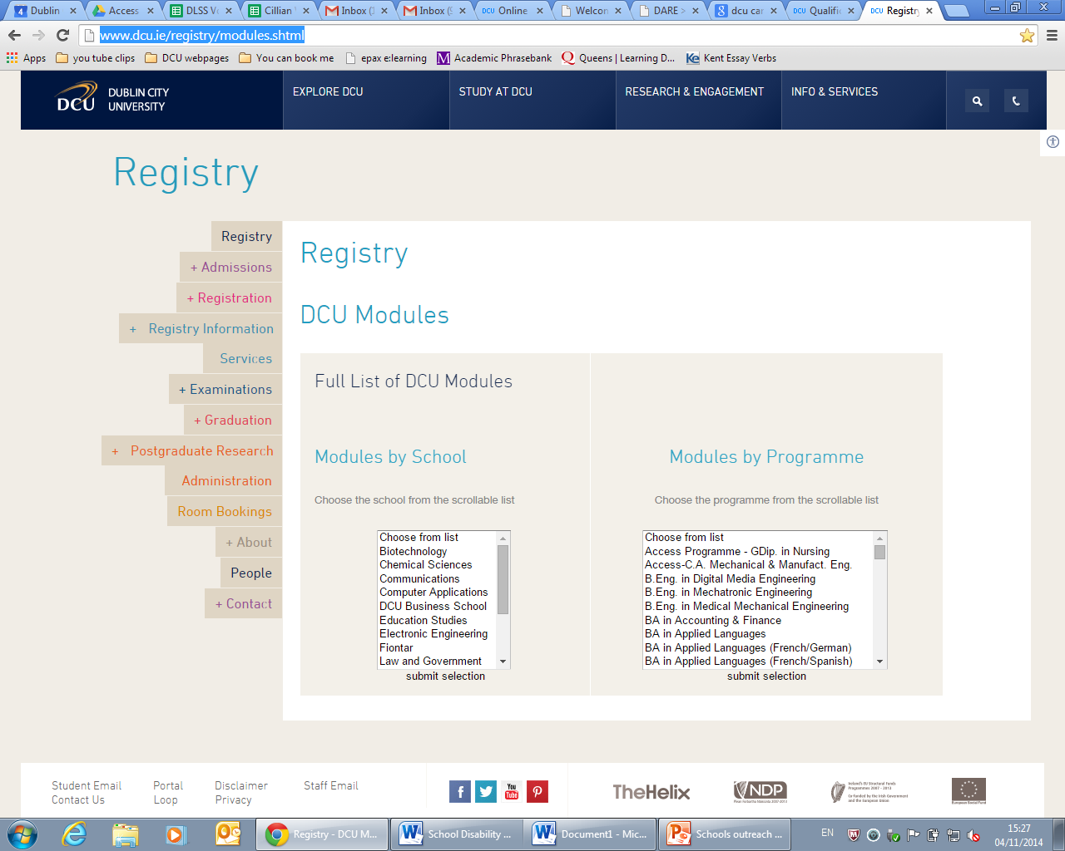
Look up the module specifications
Notes:
http://www.dcu.ie/registry/modules.shtml

Slide 5
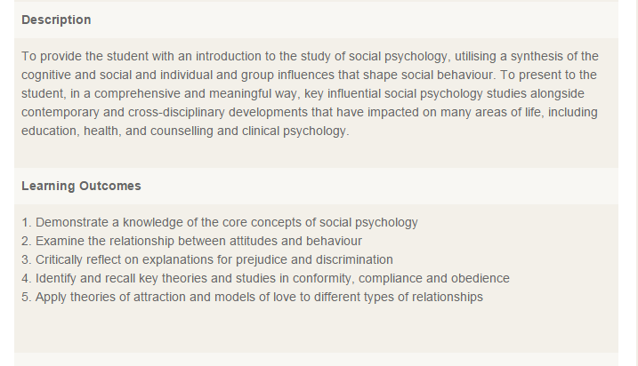
Learning Outcomes
e.g. social psychology 2014-15
Notes:
http://www.dcu.ie/registry/module_contents.php?function=2&subcode=NS123
e.g. social psychology 2014-15

Slide 6
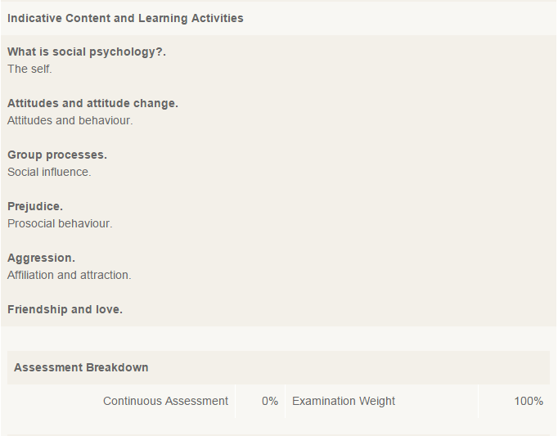
Topics
Notes:
http://www.dcu.ie/registry/module_contents.php?function=2&subcode=NS123
e.g. social psychology 2014-15

Slide 7
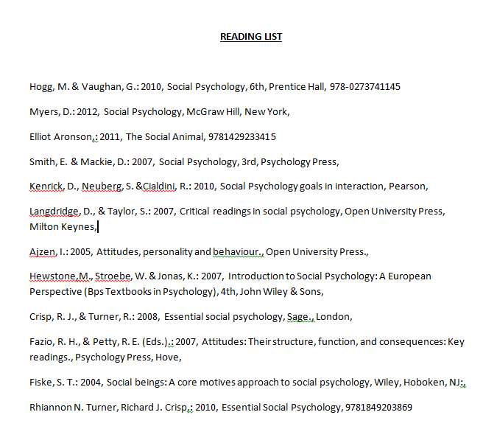
Reading List

Slide 8

Prioritising
Use past exam papers
  http://www.dcu.ie/internal/examinations/papers.php3
Link questions to areas of the course
Work out the minimum number of topics you need to revise for each paper
Find the common thread!

Slide 9
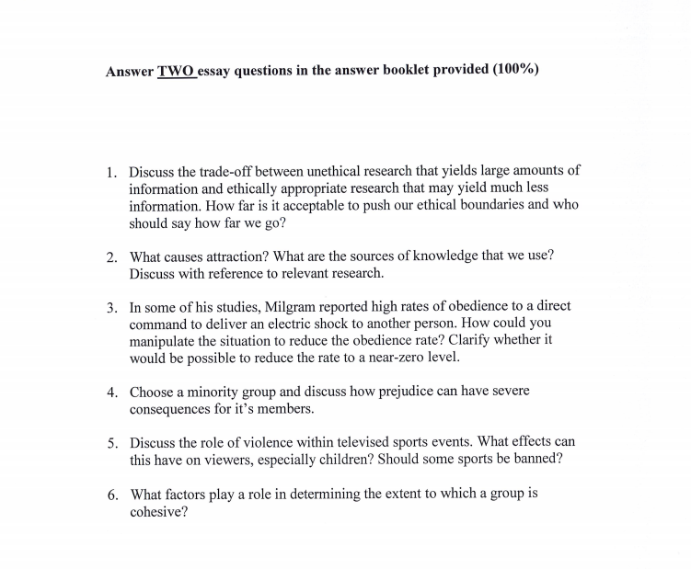
Past Papers
Social psych 2013

Slide 10
Revision Plan
Module: Social Psychology
1)Attitudes and Behaviour Change
  Lecture notes
  Tutorial notes
  Textbook chp 1
  Ajzen (2005)
  Exam Papers 2013, 2012, 2011
2)Group Processes
  Lecture notes
  Textbook chp 4
  Aronson(2011)
  Kenrick et al (2010)
  Exam Papers 2013, 2012, 2011
Notes:
See handout

Slide 11

2. WHEN

Slide 12
Timetable
time | mon | tues | wed | thurs | fri | sat | sun
9.00
10.00
11.00
12.00

Slide 13

SMART goals
Notes:
http://www.youtube.com/watch?v=1-SvuFIQjK8

Slide 14
Organise your time
To do;
Read over lecture 3 developmental psych and make notes (1 hour)
Print exam papers for module 1 and 2, file in ring-binder (45 minutes)
Download mindjet and practice 1 mind map from notes made earlier (1 hour)
Ask Sharon to test me on my notes learnt earlier (30 minutes)

Slide 15
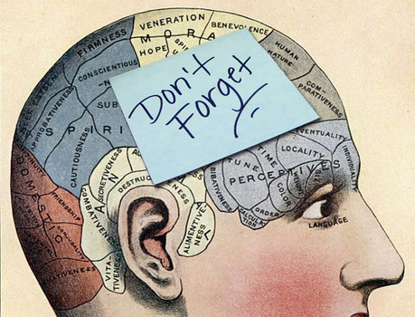
3. HOW
Notes:
Discuss with partner; How do you commit information to memory?

Slide 16

Reflection
What study techniques do you currently use?

Slide 17

Spot test
Can you quickly learn the items on the shopping list?

Slide 18
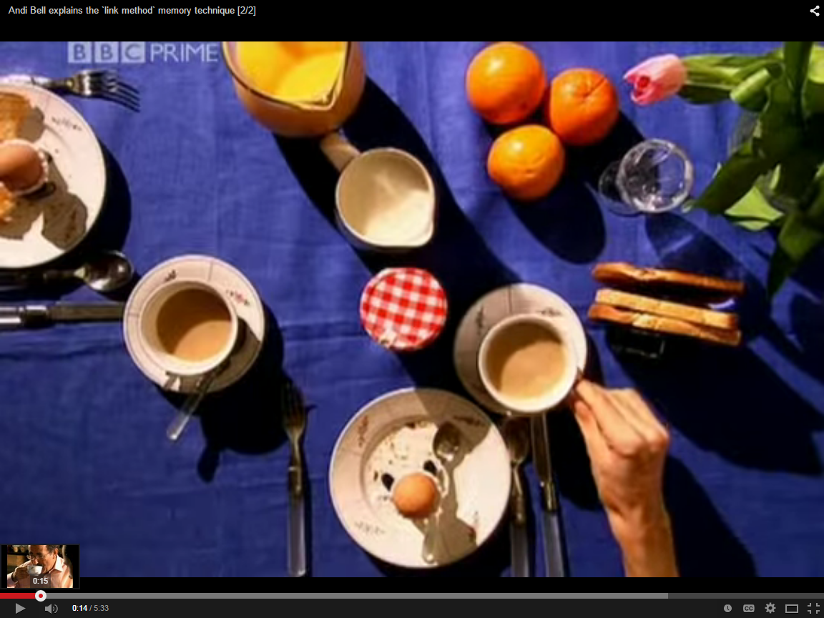
Memory Palace
Notes:
BBC clip: https://www.youtube.com/watch?v=9NROegsMqNc
Technique explained: https://www.youtube.com/watch?v=74ULwsGQwpk&noredirect=1

Slide 19
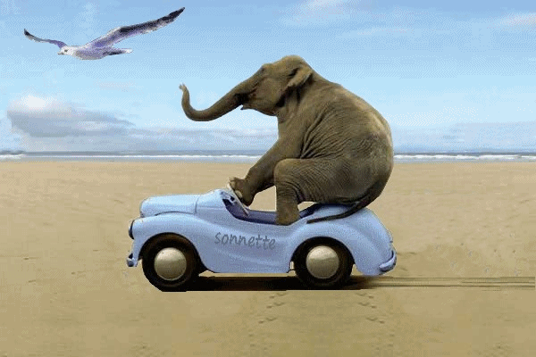
Spot test 2
Now use the memory palace technique to learn this list of animals

Slide 20
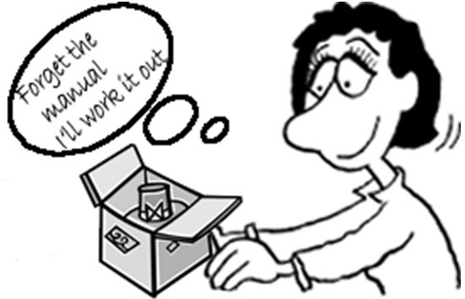

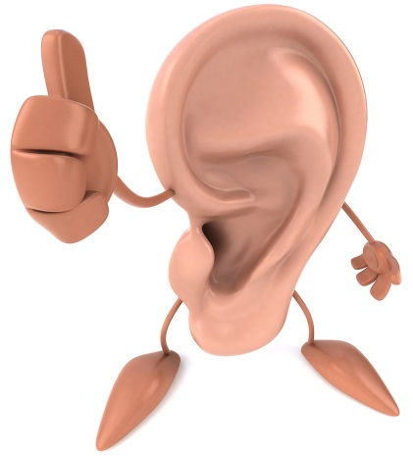
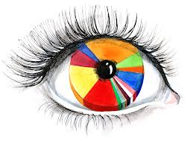
The V-A-R-K learning styles
What type of learner are you?
Notes:
Split up into the groups of learners of the same mode and share ideas

Slide 21
Combine a mixture of memory strategies
Look at it
Repeat it with rhythm
Write it
Number it
Give it a shape
Turn it into
a diagram
Say it aloud + record
Video it
Draw it
Colour it
Act it out

Slide 22
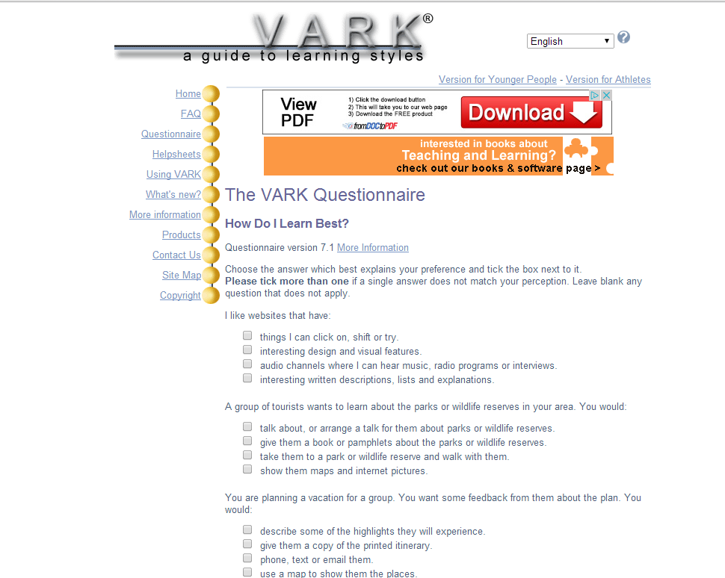
Test your own learning style
Notes:
Provide pen and paper varks to students

Slide 23
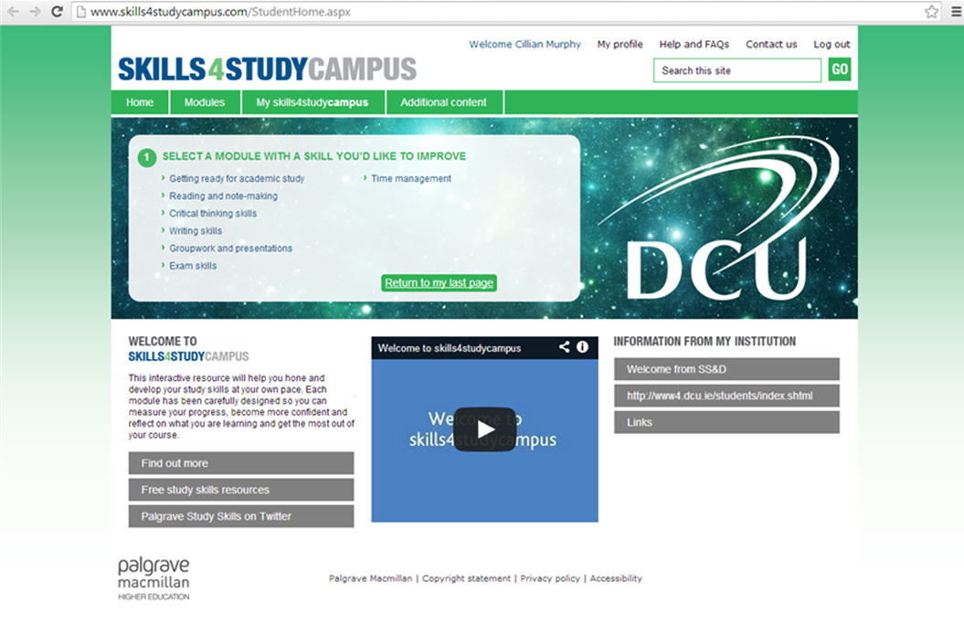
Further resources

Slide 24
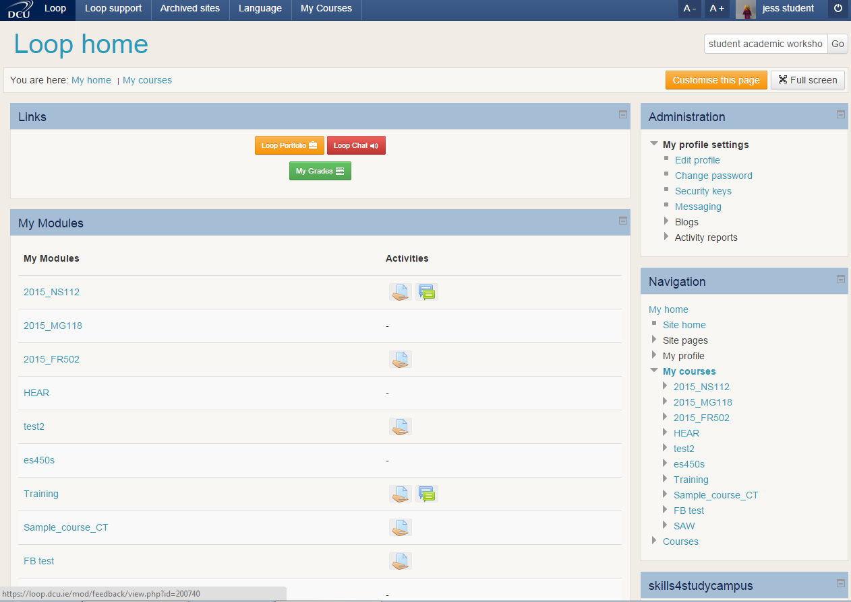
Access these slides through loop

Slide 25
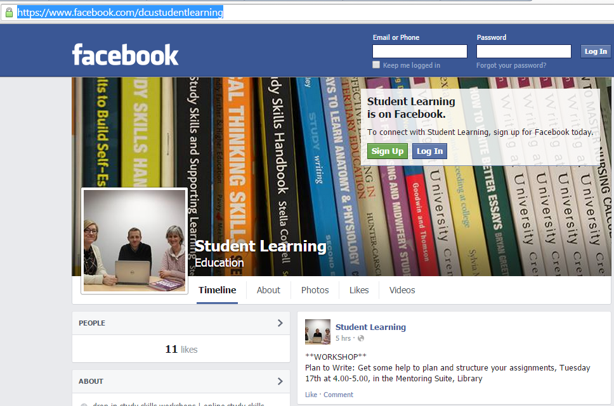

Link with us
@dcustudyskills

Slide 26
Steps to success (2)
WHAT to study
WHEN to study it
HOW to study it

Slide 27
References
Skills4Study Campus 2014. Exam skills [Online]. Available from: http://www.skills4studycampus.com/StudentHome.aspx [Accessed 28 August 2014].
VARK 2014. The VARK questionnaire [Online]. Available from: http://www.vark-learn.com/english/page.asp?p=questionnaire [Accessed 28 August 2014].

