Slide 1
Assignment Writing

Slide 2
Discussion
What are the main issues you are concerned about in assignment writing?

Slide 3
Steps
Number these steps 1-7 in order:
Plan of attack
References
First draft
Brainstorm
Choose + analyse question
Research
Revise & Edit
Notes:
1) Choose and analyse question; 2) Brainstorm; 3) Research; 4) Plan of attack; 5) First draft; 6) Revise & edit; 7) References

Slide 4
Summary: 7 Steps to Success
Analyse
Brainstorm
Research
Plan of attack
First draft
Revise and edit
References

Slide 5
Step 1: Analyse the question
Write down the question
Break the question down into the necessary parts to answer
Check key verbs and use rewordify.com to simplify the language
Now write in your own words what you are being asked to do
Use Student Learning ‘key essay verbs’ handout from website
Use rewordify.com to simplify language

Slide 6
Over To You
i) Critically evaluate the claim that the legalisation of drugs in Ireland would be of more benefit than harm to society.
Write down the question
Break the question down into the necessary parts to answer
Check key verbs or use rewordify.com to simplify the language
Now write in your own words what you are being asked to do
Notes:
In small groups, analyse title. Take ideas and feedback to wider group.

Slide 7
i) Write It Out
Example: ‘Critically evaluate the claim that the legalisation of drugs in Ireland would be of more benefit than harm to society.’

Slide 8
ii) Break It Down
Critically evaluate the claim that the legalisation of drugs in Ireland would be of more benefit than harm to society.

Slide 9
iii) Simplify the Language
Account for | Give reasons for; explain (note: give an account of; describe).
Analyse | Break the information into constituent parts; examine the relationship between the parts; question the information.
Argue | Put the case for or against a view or idea giving evidence for your claims/reasons for or against; attempt to influence the reader to accept your view.
Balance | Look at two or more viewpoints or pieces of information; give each equal attention; look at good and bad points; take into account many aspects and give an appropriate weighting to those aspects.
Be critical | Identify what is good and bad about the information and why; probe, question, identify inaccuracies or shortcomings in the information; estimate the value of the material.
Evaluate | Appraise the worth of something in the light of its truth or usefulness; assess and explain.
Notes:
Provide handout on key verb, explain it using example provided

Slide 10
iv) In Your Own Words
Critically evaluate the claim that the legalisation of drugs in Ireland would be of more benefit than harm to society
This question is about drug policy. Specifically, it is asking whether a change in drug policy in the Irish context to make drugs legal would actually be more good than bad for society. I must examine all the supporting information without accepting it at face value and weigh up its value and utility when forming my argument.

Slide 11
Step 2: Brainstorm

Slide 12
Example
Critically evaluate the claim that the legalisation of drugs in Ireland would be of more benefit than harm to society.
Notes:
As a group, come up with ideas for this topic.

Slide 13
Rough Outline Structure
Introduction
Section 2
Section 3
Conclusion
Section 1

Slide 14
Step 3: Research
Discussion: How can you find information on the topics emerging from your brainstorm?
Notes:
Draw out catalogue search, database search

Slide 15
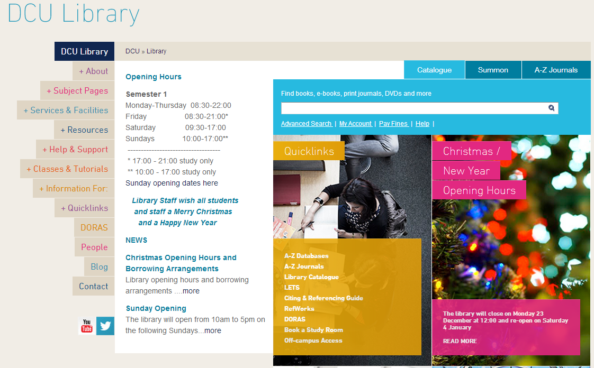
Use the Library!
Research the key topics emerging from your brainstorm/initial reading
Key textbooks from reading list/library search
Database search
Notes:
Point out key links etc on library page – subject pages, databases, e-books

Slide 16
Step 4: Plan of attack
Section | Description
Intro (10% of word count) | BROAD → SPECIFIC
Topic 1 | Sub-point 1 | Sub-point 2 | Sub-point 3
Topic 2 | Sub-point 1 | Sub-point 2 | Sub-point 3
Topic 3 | Sub-point 1 | Sub-point 2 | Sub-point 3
Conclusion (10% of word count) | SPECIFIC → BROAD → POSE A QUESTION
Paragraphs are building blocks

Slide 17
Step 5: First draft
One section at a time
One sub-point at a time
Leave intro and conclusion until the end
If struggling, record yourself talking through the point you wish to make then write out the recording
No matter what, just start writing, can always edit
Use the academic phrasebank for formal writing

Slide 18
Critical Thinking
Notes:
Optional: provide paragraph structure handout – ask them to mark where the writing addresses the stages of the critical wheel
Critical thinking is: Thinking with a purpose, Distinguishing Facts from Opinion, Evaluating Evidence, Communicating this to someone else
Critical thinking is not: Negative or destructive, ‘opposed to’ or ‘hostile’, ‘creative thinking'

Slide 19
Introductions Triangle

Slide 20
Example: Should advertising to children be banned?
BROAD – why is this question of concern?
Advertising is a major part of everyday life, found whenever we turn on the television, surf the Internet, read a magazine or even step outside our front door. It is this pervasive quality which worries some people, especially when it comes to its effect on the most vulnerable in our society, children. There is therefore the question of whether children’s advertising should be restricted or even banned. This essay will first look at the problem in terms of children’s welfare, examining research on advertising and suggesting possible areas for a ban. Then it will look at the issue from a business point of view, detailing economic drawbacks and practical difficulties.
MORE SPECIFIC –The central argument clearly expressed
SPECIFIC – How the central argument will be tackled

Slide 21
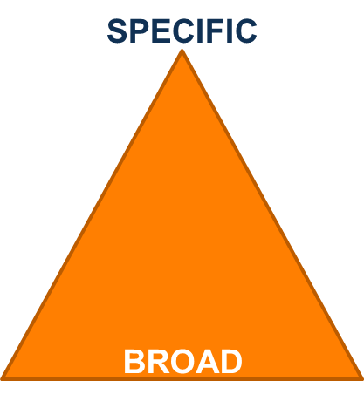
Conclusion Triangle

Slide 22
Example: Should advertising to children be banned? (2)
SPECIFIC - The main point of the piece
In conclusion then, the answer is both yes and no. Children are possibly at risk from advertising, but the risk is balanced against commercial interests. A restriction, particularly on food products, could perhaps protect children’s health. However, business would be threatened by any greater controls, and this might in turn rebound on children by lowering the quality of television programmes available to them. Perhaps what is needed most is more research on this subject so that any public debate and any demands made to industry would have the benefit of a greater foundation on which to act.
BECOMING BROADER – The points that were used to support argument
BROAD – A concluding sentence with a look to the future

Slide 23
Step 6: Revise & Edit
Technique | Explanation
Voice | Is the voice appropriate to the audience and purpose?
Cohesion | Do ideas in each sentence flow together? Do transitions between paragraphs show a connection? Are sentences long/awkward?
Referencing | Have you introduced paraphrased material and/or quotations and cited them correctly?
Notes:
When revising and editing you are investigating your piece of writing for voice and style, cohesion and organization and sources and citation style.

Slide 24
Revising Example
‘Part-time jobs can be perfect for a student if they do not interfere with school. An employer should also offer flexibility with scheduling to accommodate major projects or extra-curricular activities for school. Some employers even offer incentive programs designed to encourage students to keep up their grades.
Students like having the craic with their friends in school and it has been shown that recreational time can help ease stress.’

Slide 25
Revising Solution
COHESION: Moving from students to employers
Part-time jobs can be perfect for a student if they do not interfere with school. All employers must follow the state and federal regulations for employing minors (Walsh 2009). An employer should also offer flexibility with scheduling to accommodate major projects or extra-curricular activities for school. Some employers even offer incentive programs designed to encourage students to keep up their grades (Grady 2012).
However, studies suggest working increases stress in students (Li et al., 2015). This occurs because students enjoy interacting with their friends after school and it has been shown that this recreational time can help ease stress (Byrne et al 2008).
COHESION: connection to next paragraph
VOICE: slang
CITING: reference for the data used to back up the point

Slide 26
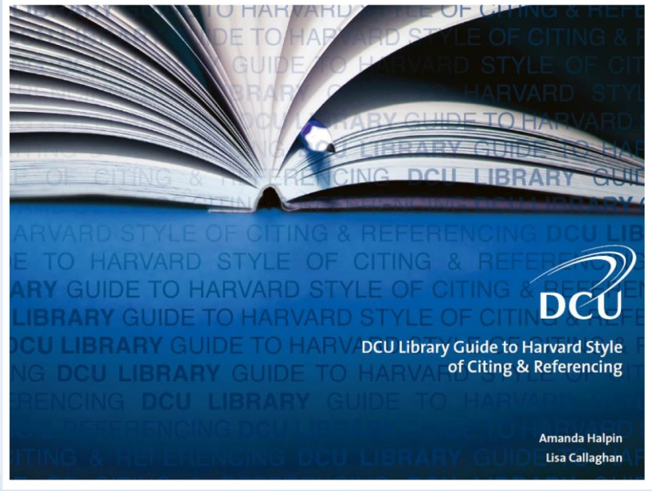
Step 7: Referencing
Library Resources:
Citing and referencing workshops
LETS cite e-tutorial
Library guide to Harvard Style of citing and referencing
Notes:
How to avoid plagiarism: https://www.youtube.com/watch?v=Yf0tIECx8BA
Citing and Referencing guide: https://www101.dcu.ie/library/Citing&ReferencingGuide/player.html

Slide 27
Summary: 7 Steps to Success
Analyse
Brainstorm
Research
Plan of attack
First draft
Revise and edit
References

Slide 28
Questions

