Slide 1
Group work
Student Learning
www.dcu.ie/studentlearning

Slide 2
Group Brainstorm
What are the issues you’ve previously experienced in completing groupwork?

Slide 4
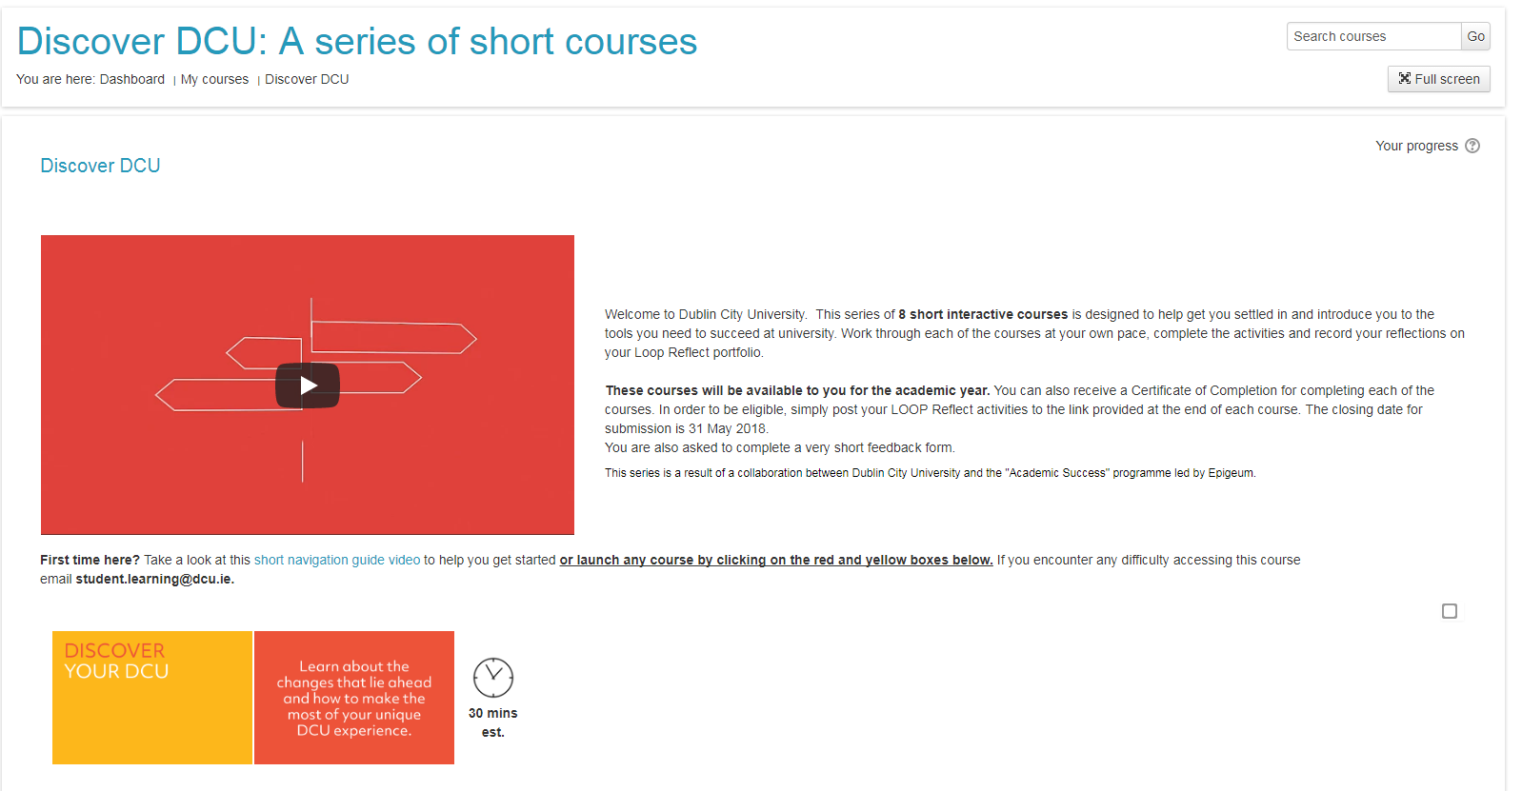

Slide 5
Learning outcomes
Three steps to success:
Get to know each other
Clarify the task
Set ground rules
Source: Trinity College Dublin (2017)

Slide 6
Activity
Split into three groups.
Group 1): Ideas for how to get to know each other.
Group 2): What can we do to understand the task?
Group 3): What rules for the group are important?

Slide 7
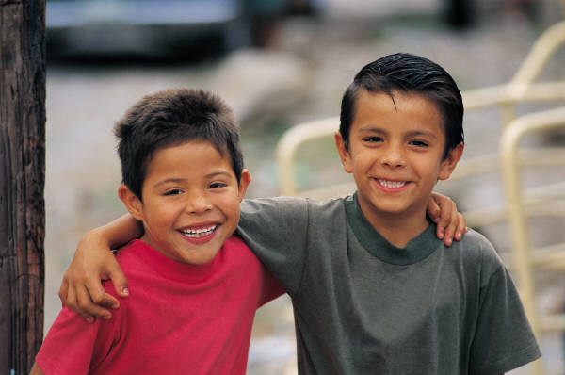
Step 1: Get to know your group
Chat to another person in the group and ask them the following, before reporting back about them to the rest of the team:
Have you done groupwork before in the past?
If so, what worked in the group?
Do you have any interests or skills relevant to this project?
One thing you are looking forward to about this group?
One thing you are apprehensive about this group?
Create a master list of contact details
Notes:
Icebreakers: http://humanresources.about.com/od/icebreakers/a/my-10-best-ice-breakers.htm

Slide 8
Step 2: Understand the task
Analyse the brief
What is the expected final output?
Final deadline?
Break down the question/title and check for understanding
Brainstorm
Divide up the work
Divide the work amongst different people
Task manager appointed to ensure people working independently

Slide 9
Task Summary
Title: As a team, prepare and present a fifteen minute powerpoint presentation to argue for the motion that ‘The compulsory teaching of Irish in primary schools is a threat to inclusive education.’
Research 3 key areas and provide 3 key points for each. Deadline 1/3/15.
Barrier to inclusive profession for non-nationals (Ian)
Barrier to children with SEN (Emma)
Non-relevance of language to ethnic minority groupings (David)
Proof read everyone’s input (all group members). Deadline 3/3/18
Prepare slide show (Aoife). Deadline 5/3/18.
Present the powerpoint to group (Aoife). Deadline 7/3/18.
Task Manager: David

Slide 10
Step 3: Ground rules
List the group members’ expectations of each other
Meetings: how often and where?
Staying in contact
Leader: permanent, rotating, none?
Decision on how to reach agreement in meetings – consensus? Majority rules?
Keep minutes at meetings?
Agreed action points after meetings?
Source: Trinity College Dublin (2017)

Slide 11
Potential Problems
What issues could arise when working in a group?

Slide 12
…
People can be so difficult
Tina
Tina is frequently late for group meetings. When she gets there she is often on her phone and just nods with what everyone else says. She doesn’t volunteer to do work and has yet to produce anything for the group.
Tom
Tom does all the emailing and texting to sort group meetings. At the meetings he takes the lead and tends to push his ideas forward and argues with everyone else’s ideas. He tells people to do different tasks as if he is the boss.
Notes:
Activity: break into groups for different case study. Ideas for how to manage these people?
Example clip of group going wrong http://archive.learnhigher.ac.uk/groupwork/episode1/

Slide 13
Get by with a little help….
If problems cannot be resolved within the group, talk to your lecturer/tutor

Slide 14
Summary
Three steps to success:
Get to know each other
Understand the task
Set group rules

Slide 15
References
Learn Higher 2007. Episode 1 – the first meeting [Online]. Available from http://archive.learnhigher.ac.uk/groupwork/episode1/ [Accessed 28 August 2014]
Skills4Study Campus 2014. Groupwork and presentations [Online]. Available from: http://www.skills4studycampus.com/StudentHome.aspx [Accessed 28 August 2014].
Trinity College Dublin 2017. Managing groupwork [Online]. Available from: https://student-learning.tcd.ie/about/what/workshops/ [Accessed 11 October 2017].

